Slide 1
Python Lab: Step-By-step Machine learning
Women Who Code DC

Slide 2
CODE OF CONDUCT
WWCode is a non-profit organization dedicated to inspiring women to excel in technology careers. We are committed to our mission statement and equally committed to providing a harassment-free experience for everyone regardless of gender, gender identity and expression, sexual orientation, ability, physical appearance, body size, race, ethnicity, age, religion, socioeconomic status, caste or creed. We do not tolerate harassment of event participants in any form. Event participants violating these rules may be sanctioned or expelled permanently, at the discretion of the event organizers, which in most cases are members of the WWCode leadership team.
MONTHLY PYTHON LAB
WWCode has a monthly Python lab on the 3rd Wednesday and a Beginners Night @Fiscal Note every other first Wednesday of the Month from 6:30-8:30pm.
JOIN THE SLACK COMMUNITY
Join the Slack community at http://bit.ly/wwcdcslack

Slide 3
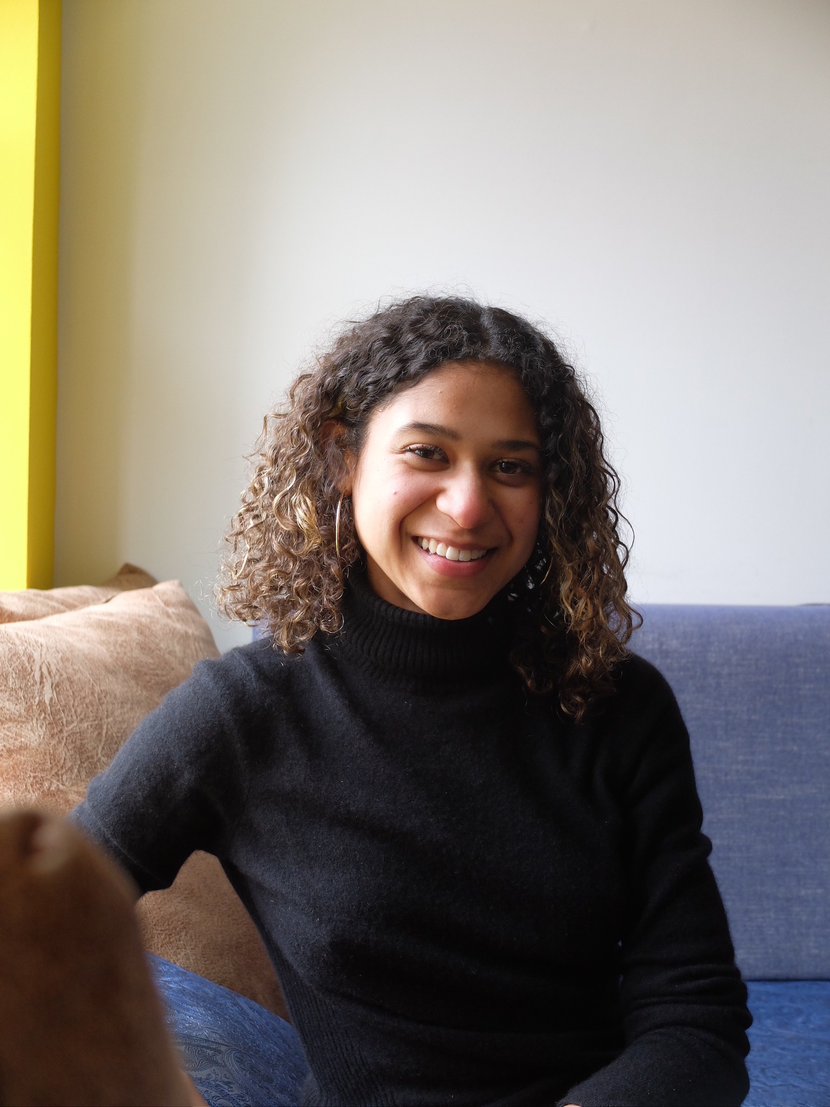
Brianna raquel mcgowan - codetomove.com
About Me:
I am a developer, poet, data scientist, advocate, and dancer passionate about intersecting worlds. I encourage people to boldly envision a future that defies the status quo.
I code to move women and people of color into tech, and change the face of the industry. We challenge the bias in our data and demand integrity.

Slide 4
So...What is ML?
Machine Learning is a method of data analysis that automates analytical model building. It is a branch of artificial intelligence based on the idea that systems can learn from data, identify patterns and make decisions with minimal human intervention.
They say the last frontier of AI is humor…
Note: This lab is inspired by: (we will be doing this ex.) https://machinelearningmastery.com/machine-learning-in-python-step-by-step/

Slide 5
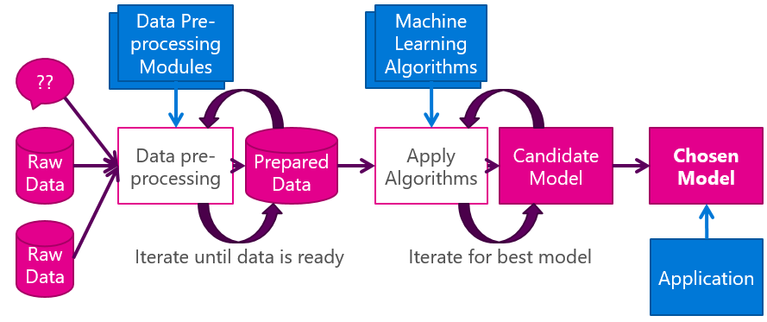
Flow
Notes:
Thanks for the img Martin: http://martink.me/articles/machine-learning-is-for-muggles-too

Slide 6
Supervised vs. Unsupervised learning
Supervised:
The most common. Scientists teach the algorithms that form the models what conclusions it should come up with. Requires the output is already known and correct answers to train the models, so that it can follow the pattern and replicate it.
Unsupervised:
Use algorithms to form models that can find differences in data and group differences by patterns without human guidance.

Slide 7
Supervised
Ex. Linear Regression Algorithm
h(Xi) = β0 + β1(xi) + ε
Β0 and β1 are coefficients that represent y-intercept and slope. Xi are the variables. ε is the error (noise).
OP = a + (2*b) + (3*c)
X-Train (a, b, c are random from 0 to 1,000)
X-Test = [10,20,30]
Train our model. Output should be 140.
Notes:
Because we are training our model to make predictions, this is supervised learning. We know what our output should be, and testing the model to make sure it’s accurate.

Slide 8
To the code
We will be using the Iris.csv data set. It is like the “Hello World” of data sets.
Collab URL:
https://colab.research.google.com/drive/16usAmhH83CGJCGReh4OXH8hw-P2epJkj

Slide 9
Load the data Set
1 2 3 4 | # Load dataset url = "https://raw.githubusercontent.com/jbrownlee/Datasets/master/iris.csv" names = ['sepal-length', 'sepal-width', 'petal-length', 'petal-width', 'class'] dataset = pandas.read_csv(url, names=names)

Slide 10
Analyze the data
Dimensions of the dataset.
Peek at the data itself.
Statistical summary of all attributes.
Breakdown of the data by the class variable.

Slide 11
Visualize the data set
Understand the attributes
Understand the relationship between the attributes.

Slide 12
Evaluate some algorithms
We will split the loaded dataset into two, 80% of which we will use to train our models and 20% that we will hold back as a validation dataset.
Separate out a validation dataset.
Set-up the test harness to use 10-fold cross validation.
Build 5 different models to predict species from flower measurements
Select the best model.

Slide 13
Build Models
Let’s evaluate 6 different algorithms:
Logistic Regression (LR)
Linear Discriminant Analysis (LDA)
K-Nearest Neighbors (KNN).
Classification and Regression Trees (CART).
Gaussian Naive Bayes (NB).
Support Vector Machines (SVM).

Slide 14
Which model was best?
The KNN algorithm is very simple and was an accurate model based on our tests. Now we want to get an idea of the accuracy of the model on our validation set.

Slide 15
Q&a
Ask me anything! Feedback?

